Slide 1
E-commerce Analysis - Optimizing sales & productivity
Team 1

Slide 2

Introduction
Dataset
2171 of Amazon Best Sellers
Web Scrapping
BeautifulSoup – parsing through HTML documents
Selenium – browser automation
Webdriver – interacting with web elements
Data Analysis
Pandas
Dyplr
Tidyverse

Slide 3
Variables
Product Name
Department
Price
Star Rating
Brand
# of Ratings
Rank in Department
Color

Slide 4
Table of contents
01
03
02
04
Regression Analysis
Brand Analysis
Relationship between price and star rating/number of ratings.
Looking at brand popularity and how that plays a role.
Price Distribution
Insights & Recommendations
Analyzing the price distribution of products.
Recommendation system & data insights.

Slide 5
01
Regression Analysis

Slide 6
OLS (Ordinary Least Squares) Regression
R^2 : 0.037
Does star rating & number of ratings affect price?
Independent Variables
Dependent Variable
R^2 & F-statistic Test
Price
coef : 60.1175
p-value: 0.527
Star Rating
# of Ratings
F-Statistic
coef : -0.0887
p-value: 0.125
F-statistic : 1.381
p-value: 0.258

Slide 7
Interpreting the Numbers
0.527
0.125
3.7%*
1.381
Star Rating
Number of Ratings
Coefficient is not statistically significant
Coefficient is not statistically significant
R^2
F-Statistic
Low r^2 value indicates low explanatory power.
Overall model is not statistically significant
3.7% of the variance in the price can be explained by the number d star rating.
*3.7% of the variance in price can be explained by the star rating and number of ratings

Slide 8
02
Price Distribution

Slide 9
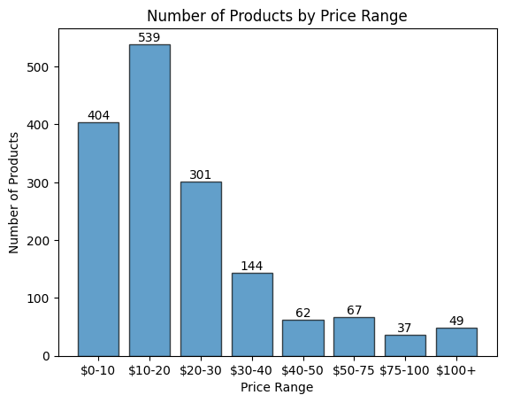
The Number of Products by Price
Divided into 8 Price Ranges
Right Skewed
Majority of products < $30
Which departments dominate the top price ranges?

Slide 10
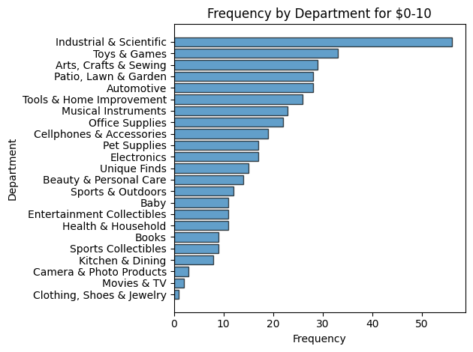
$0-10 Price Range by Department
Industrial & Scientific was the most common (contains products like toilet paper, exam gloves, light bulbs, etc.)
Unsurprisingly, Camera & Photo, Movies & TV, and Clothing, Shoes & Jewelry came last

Slide 11
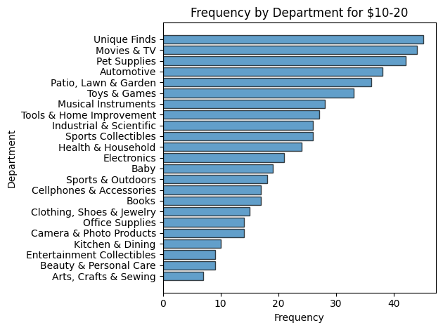
$10-20 Price Range by Department
Unique Finds, Movies & TV, and Pet Supplies were a close top 3
Arts, Crafts & Sewing was last, though it was third in the $0-10 range
This was the most common range overall

Slide 12
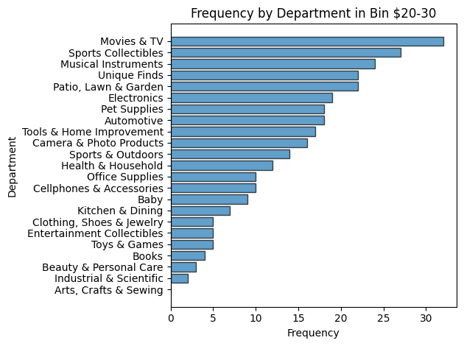
$20-30 Price Range by Department
Movies & TV tops the $20-30 range
Industrial & Scientific and Arts, Crafts & Sewing barely had any products in this range
How would the distribution change based on department?

Slide 13
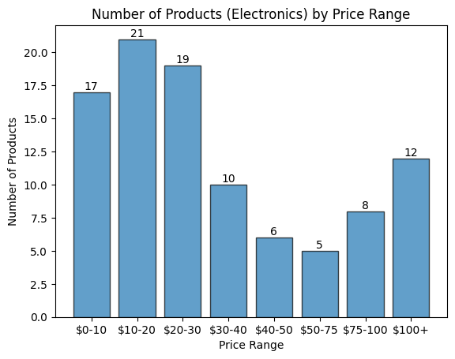
Electronics
One of the top departments (total reviews)
Products either $10-30 or $75+

Slide 14
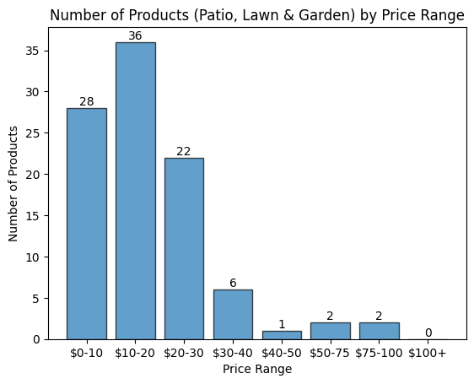
Patio, Lawn & Garden
Top 5 in all 3 of the top price ranges by department ($0-10, $10-20, $20-30)
Right Skewed (products tend to be less than $30)

Slide 15
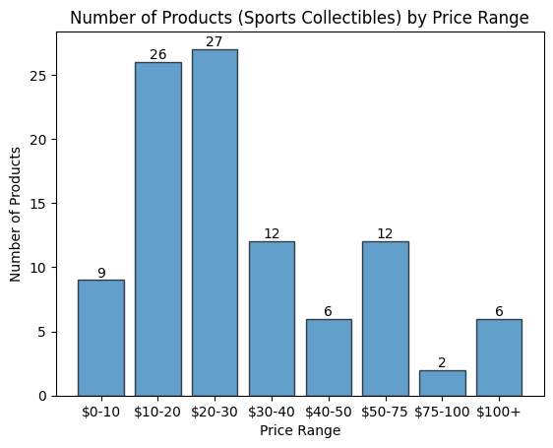
Sports Collectibles
Very niche department (mostly sports cards & signed memorabilia)
Erratic distribution (products in many different price ranges)

Slide 16
03
Brands Analysis

Slide 17
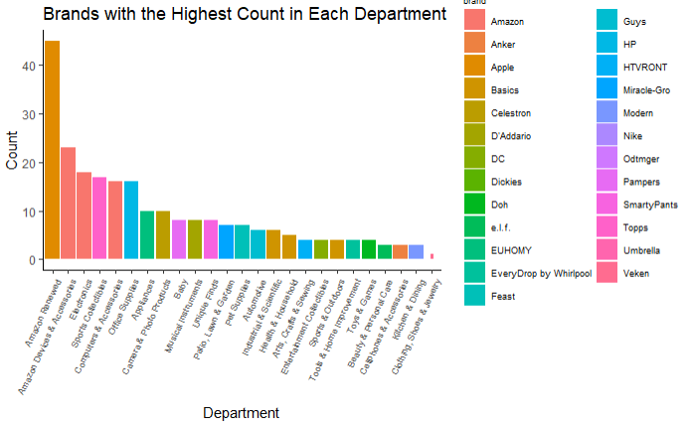
Brand Counts
Amazon and Basics tied for appearances (3)
Mostly well known brands
Apple has significant presence in Renewals

Slide 18
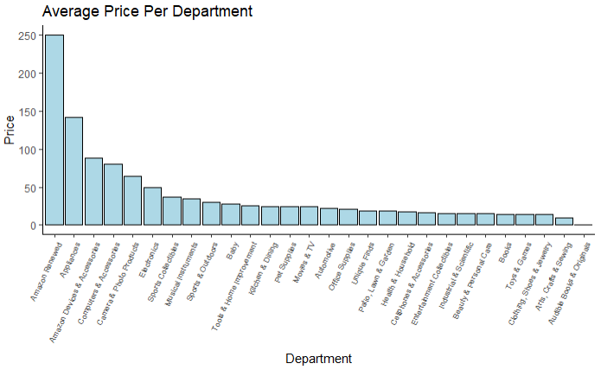
Average Price By Department
Tech and electronics have the highest average

Slide 19
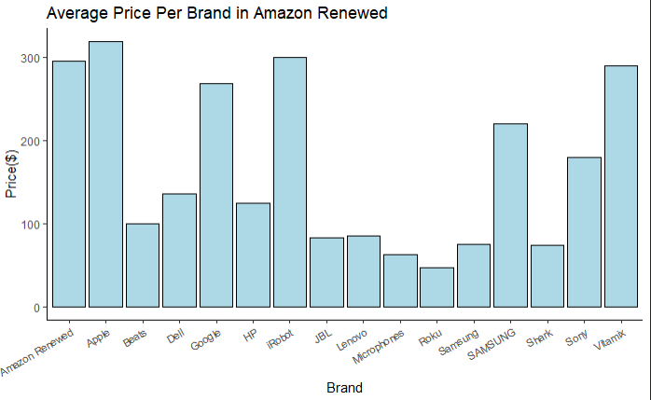
Department: Amazon Renewed
No relation between the count of brands and average.
Vitamix has one product yet similar price

Slide 20
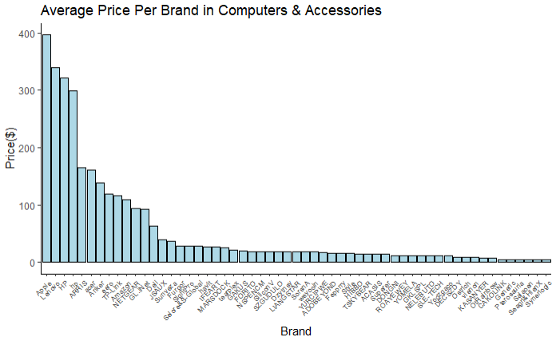
Department: Amazon Devices & Accessories
Despite having the most amount of products, Amazon does not have higher prices
Well known brands like HP, Apple, and Lenovo have the highest averages
Average is skewed by low price accessories from small brands

Slide 21
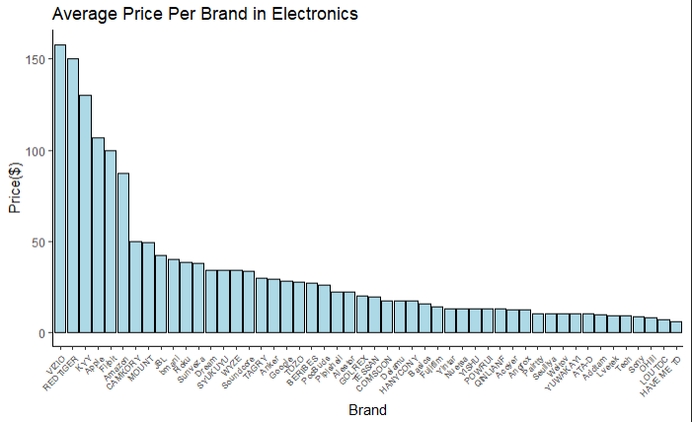
Department: Electronics
Again, Amazon does not have the highest average price
Less known brands (aside from Apple) have the highest
Also skewed by low price items at the bottom

Slide 22
04
Insights & Recommendations

Slide 23
What Factors Determine a Good Price?
Good Prices are:
Comparable among other prices in a department
Competitive with potential substitute products price
At a reasonably low price, as customers prefer cheaper products

Slide 24
Recommending Prices based on Findings

Slide 25
Price Recommendation Process
1. Tailor Prices to Department Prefrences
2. Focus on Value Proposition
3. Leverage Brand Recognition
Each department showed varying price preferences. When looking to optimize sales; analyze the distribution of that departments sales & price ranges.
Don’t only rely on star ratings or number of ratings to justify pricing. Instead focus on highlighting the features and quality of the product.
In each department there was a brand that was more prevalent, and it was typically a recognized brand. Highlight reputation and reliability of established brands to boost sales.

Slide 26

Looking at the Future
Data Extraction
If given more time and resources, more data would have been beneficial.
Target Small-Mid Sized Ecommerce Business
More willing to share their sales data and bigger opportunity for impact.

Slide 27
Thanks!
Do you have any questions?

